Slide 1
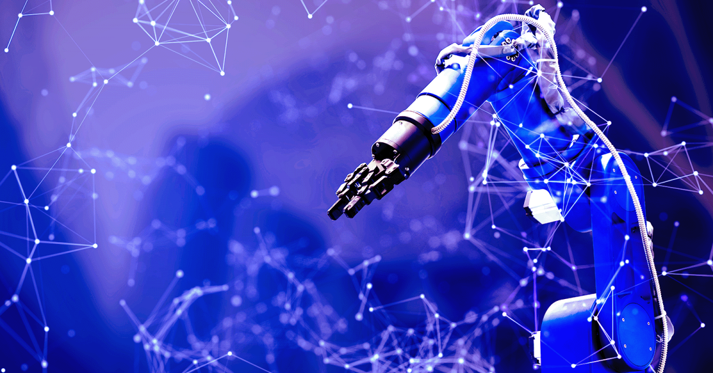


Robotics Systems
Mechatronics Engineering department
Presentation By:
Adham Abdelmohsen
Elzewel
Supervised By:
Prof.Dr. Ahmed Hweidi

Slide 2

Abstract
industry has increased the focus on a number of technologies. These technologies help realize the vision of intelligence cities .One emerging aspect of Industry is human-robot co-working. With the help of artificial intelligence, the internet and Industry visions, there will be two predominant types of systems interfacing with people in intelligent cities. They are robotics and intelligence systems. The increasing deployment of them will help in making cities smarter. And we need to see advancements in relevant key technologies, including power and networking technologies.

Slide 3
Acknowledgment
I would like to express our appreciation to our esteemed instructor, Prof.Dr Ahmed Hweidi. for choosing to impart their knowledge and skills to us. whose guidance and expertise have been invaluable throughout the research process.

Slide 4
Introduction
The term "robotics" is no longer confined to the realm of science fiction; it is an integral part of our reality. The journey of robotics traces back through time, from early automata to the sophisticated, artificially intelligent systems that characterize the present day. As we stand at the crossroads of human ingenuity and technological innovation, the need to understand and critically assess the role of robotic systems in our society becomes increasingly paramount.

Slide 5
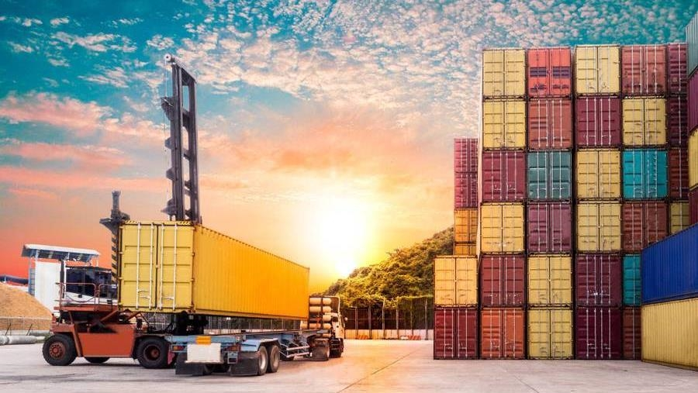
Topic One
Robotics system

Slide 6
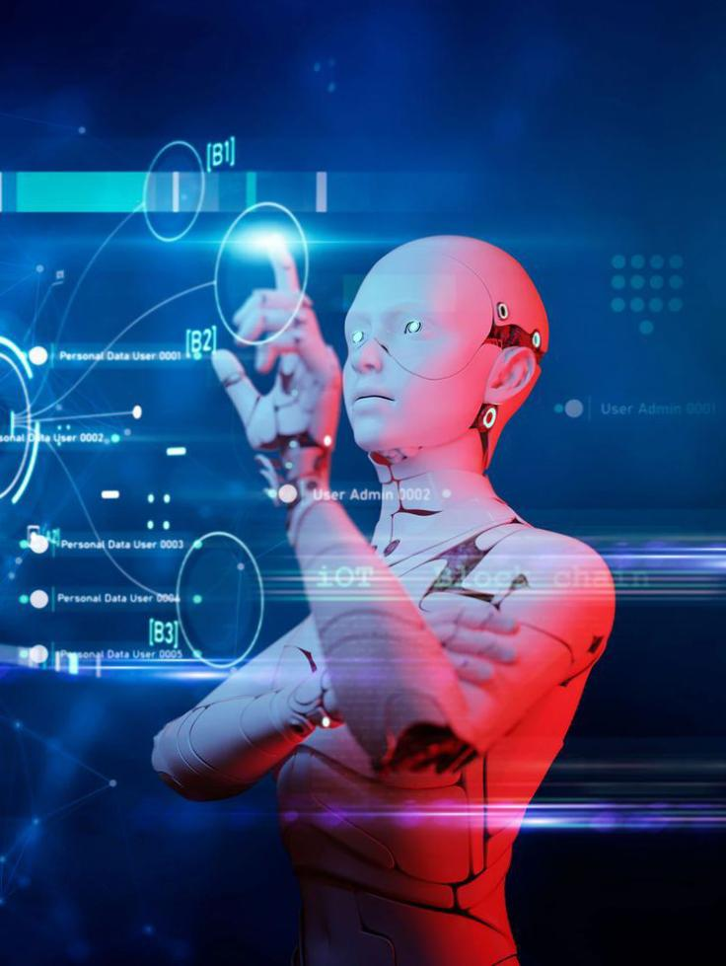
Robotic systems provide intelligent services, information and data by interacting with the environment, including human beings, via the use of various sensors, actuators and human interfaces
Robotics system Dynamics of robotics systems
Analysis of robotics systems Control of Robotic Systems

Slide 7
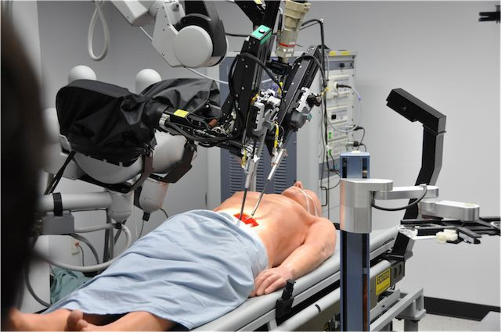
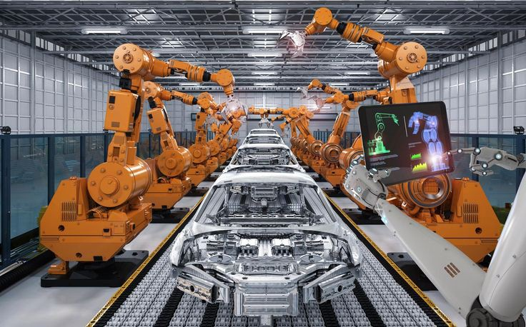
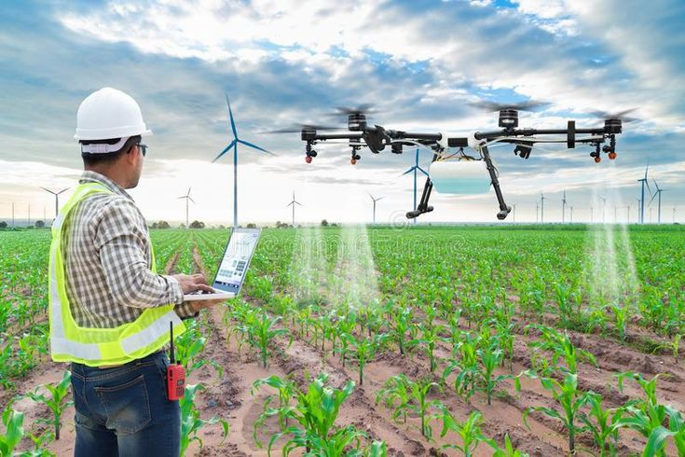
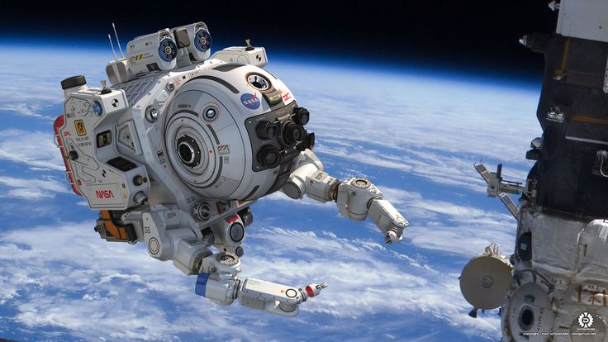
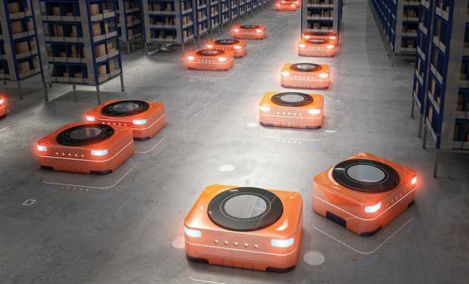
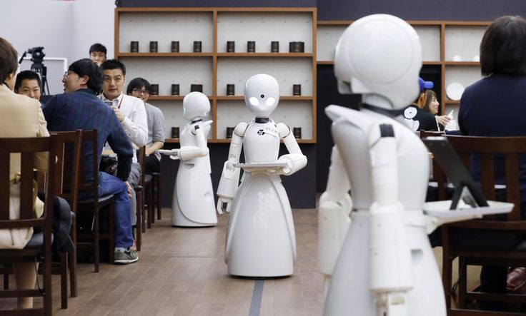
Types of Robotic Systems
Industrial robotics Medical robotics Agricultural robotics Space robotics Collaborative robotics (cobots)
Autonomous robotics
Security robotics

Slide 8
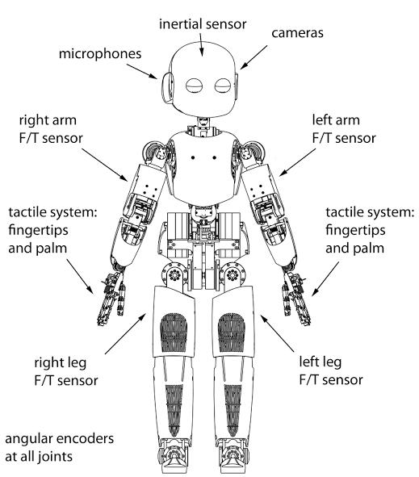
Components of Robotic Systems
Sensors
Actuators
Control system
Power Supply
End Effectors
Communication interface
CPU
Vision
Electric motors
Programming system

Slide 9
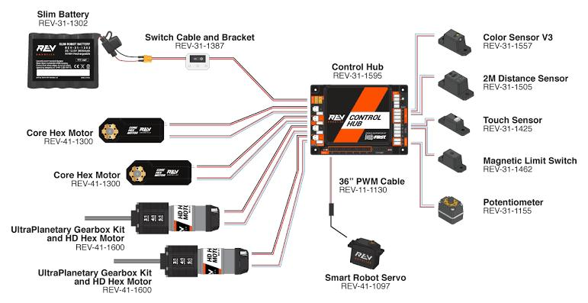
Control Systems in Robotics
The efficiency and precision of robotic systems hinge on the design and implementation of their control systems.
1. Open-Loop Control.
2. Closed-Loop Control.
3. Autonomous Control.
4. Teleoperation.
5. Hybrid Control Systems

Slide 10
Challenges & Limitations in Robotic Systems
While robotic systems continue to advance at a rapid pace, they face a myriad of challenges and limitations that impact their widespread adoption and effectiveness.
They are more challenging to train than humans, require high investment and maintenance costs, and pose safety concerns.
Cost.
Ethical Considerations
Technical Limitations.
Safety Concerns.
Lack of Standardization.
Human-Robot Interaction.
Inflexibleity

Slide 11
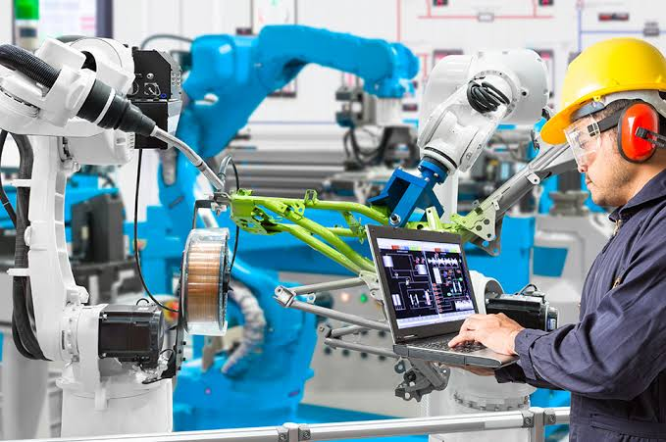
Applications of Robotic Systems
Manufacturing and Industrial Automation. Healthcare and Medical Robotics. Agriculture Space Exploration. Logistics and Warehousing Service and Hospitality. Autonomous Vehicles. Education and Research

Slide 12
Impact of Robotics on Society
The widespread integration of robotic systems into society has profound implications across various facets of human life.
1.Workforce Changes.
2.Economic Dynamics.
3.Ethical Considerations.
4.Education and Skills Development.
5.Accessibility and Inclusion.
6.Ethical Use of AI.

Slide 13
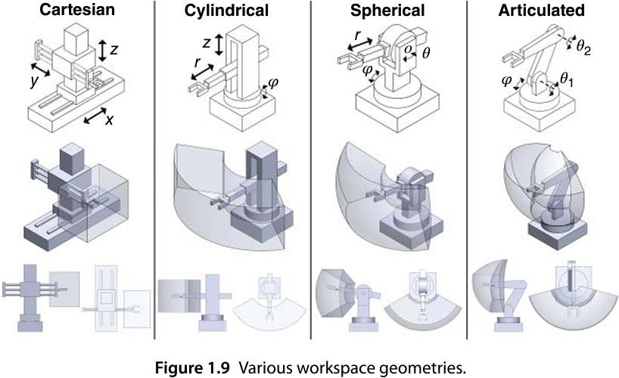
Examples of Robotic Manipulators

Slide 14
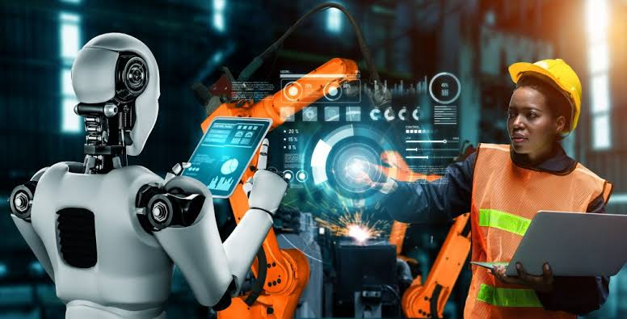
Future Trends in Robotic Systems.
Advanced Artificial Intelligence. Human-Robot Collaboration. Swarm robotics Soft Robotics. Robotic Biotechnology. Eco-Friendly and Sustainable. Personal and Service Robots

Slide 15
Topic two
Dynamics of robotics systems

Slide 16
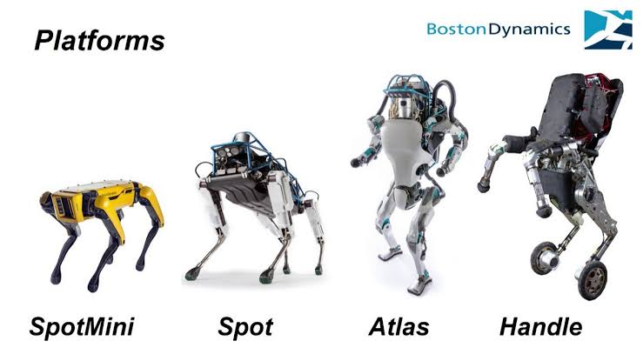
The dynamics of robotic systems refer to the study of the motion and behavior of robots as influenced by external forces, control inputs, and internal mechanical structures. Understanding the dynamics is crucial for designing, controlling, and optimizing the performance of robotic systems.

Slide 17
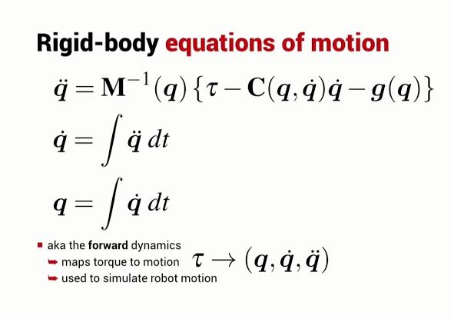
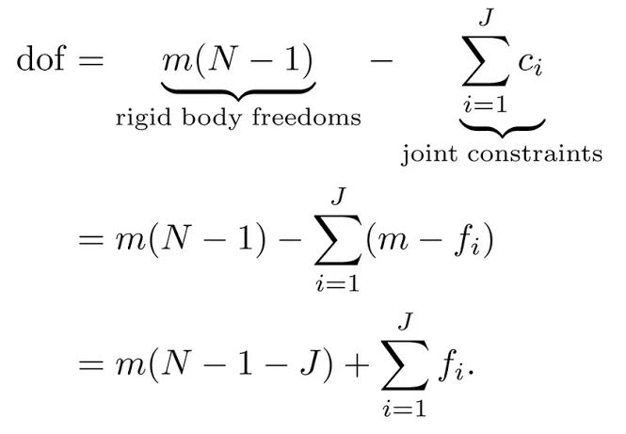
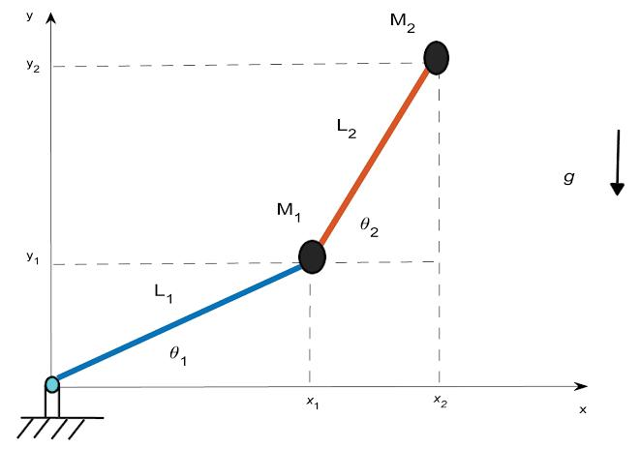
Dynamics Equations
Manipulator rigid body dynamics are governed by this equation:
ddt[q˙q]=[˙qM(q)−1(−C(q,˙q)˙q−G(q)−J(q)TFExt+τ)] also written as:
M(q)¨q=−C(q,˙q)˙q−G(q)−J(q)TFExt+τ

Slide 18
Here are key aspects of the dynamics of robotic systems:
Kinematics vs. Dynamics Equations of Motion. Robot Joints and Links Forces and Torques. Dynamic Models Control and Trajectory Planning. Impact of External Forces. Dynamic Stability Dynamic Modeling Tools

Slide 19
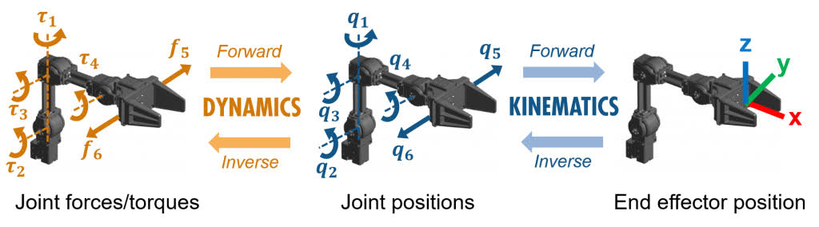
Overview of Robotics Dynamics and Control Problems:
Two main problems related to the robot dynamics are forward and inverse dynamics problems. Forward dynamics (FD) solves the motion from the forces, while inverse dynamics (ID) solves the forces from the motion .

Slide 20
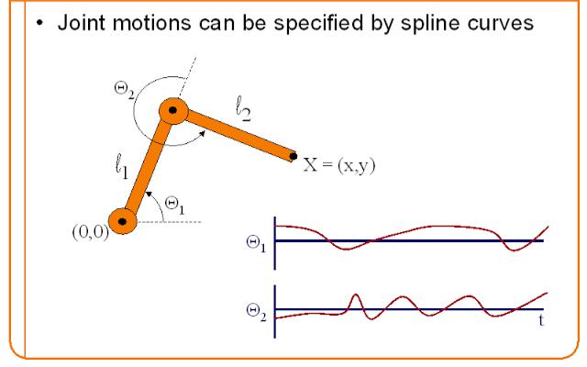
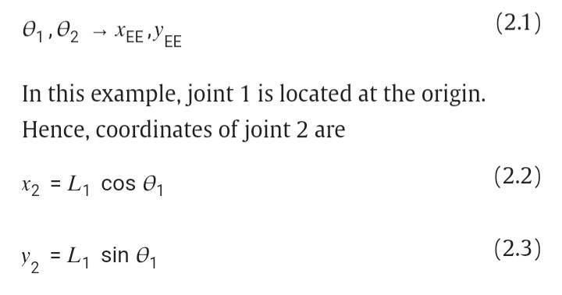
Forward Kinematics:
process of obtaining position and velocity of end effector, given the known joint angles and angular velocities. For example, if shoulder and elbow joint angles are given for arm in sagittal plane, the goal is to find Cartesian coordinates of wrist/fist.In our particular case we are looking for transformation

Slide 21
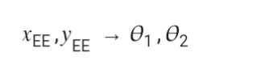
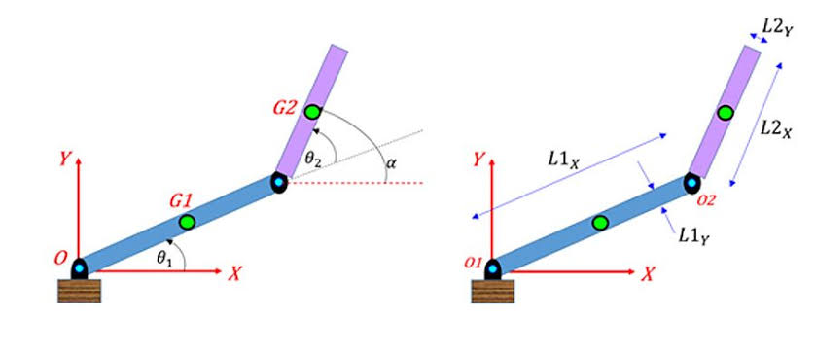
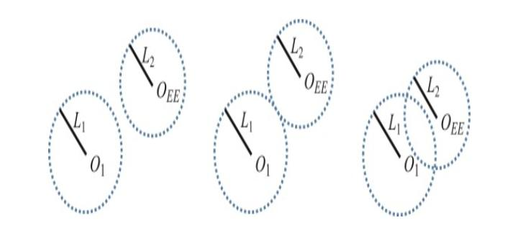
Inverse Kinematics:
Process of obtaining joint angles from known coordinates of end effector. For example, if wrist/fist Cartesian coordinates are known, the goal is to decipher shoulder and elbow joint angles for arm in sagittal plane.

Slide 22
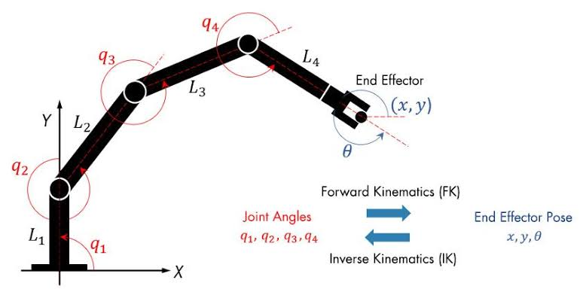

Slide 23
Forward Dynamics:
The problems of forward kinematics and inverse kinematics are purely geometric in nature.
For many of the robotic systems studied in this book, the governing equations can be written in the form
M(q(t))q¨(t) = n(q(t), q˙ (t))+ 𝑟(t).

Slide 24
Inverse Dynamics and Feedback Control:
The problem of forward dynamics can be solved to understand how a specific set of input forces and torques in (t) induce a corresponding time history of the joint variables q(t) for t ≥ O.
problem can be described as finding the dynamic behavior of the system given an input actuation time history (t), t≥ O.

Slide 25
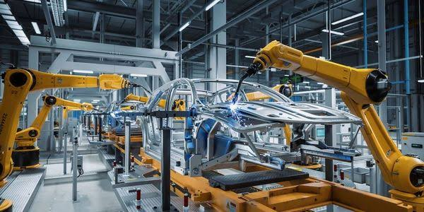
Dynamics and Control of Robotic Vehicles:
The fundamental dynamics and control problems for robotics, and their role in the study of a typical flapping wing robot.

Slide 26
Topic three
Analysis of robotics systems

Slide 27
Elements in the analysis of robotic systems
1.System Architecture
-Component Analysis
-Interconnectivity
2.Kinematics and Dynamics
-Kinematic Analysis
-Dynamic Analysis
3.Control System Analysis
-Controller Design
-Feedback Systems

Slide 28
Elements in the analysis of robotic systems
4.Performance Metrics
-Accuracy
-Speed and Throughput
-Repeatability
5.Energy Efficiency
-Power Consumption
-Optimization
6.Sensitivity Analysis
-Sensitivity to Parameters
-Robustness Analysis

Slide 29
Elements in the analysis of robotic systems
7.Workspace Analysis
-Reachability. -Dexterity
8.Safety Analysis
-Collision Avoidance
-Emergency Stop Systems
9.Task-Specific Analysis
-Application-Specific Metrics
-Optimization for Task Requirements

Slide 30
Elements in the analysis of robotic systems
10.Human-Robot Interaction Analysis
-User Experience
-Safety Protocols
11.Cost-Benefit Analysis
-Cost of Implementation
-Return on Investment (ROI)
The goal is to ensure that robotic systems meet performance requirements, adhere to safety standards, and provide value in their respective applications.

Slide 31
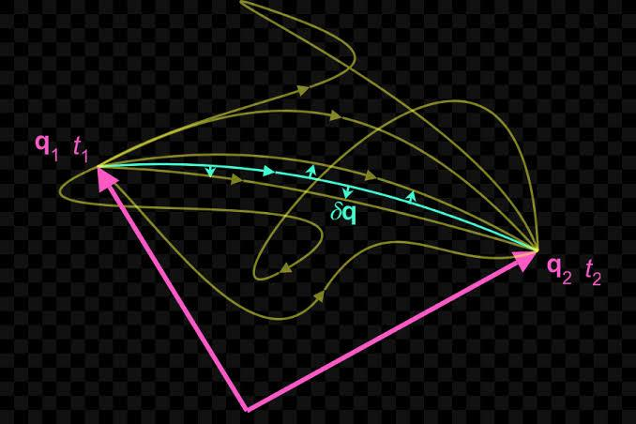
Analytical Mechanics.
Analytical mechanics uses scalar properties of motion representing the system as a whole (KE)&(PE)
1. Hamilton’s Principle.
2. Functionals of Variations.
3. Hamilton’s Principle for Conservative Systems.
4. Lagrange’s Equations for Conservative Systems.
5. Lagrange’s Equations for Robotic Systems.

Slide 32
Topic four
Control of Robotic Systems

Slide 33
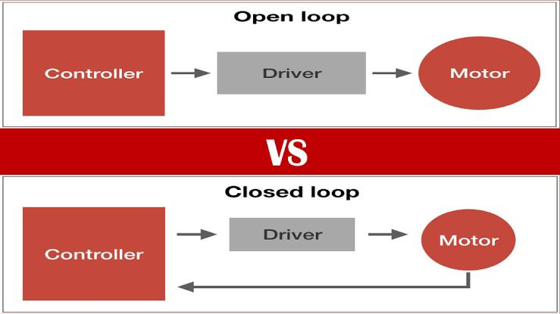
Open Loop and Closed Loop
open-loop control in motion systems means that there is no position feedback of a moving object. Closed-loop control means that there is some kind of position information that is fed back to the motion controller of a system and that is used in the positioning process

Slide 34
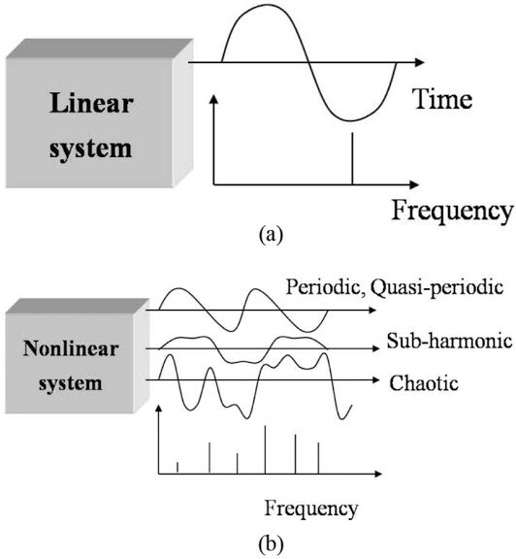
Linear and Nonlinear Control systems
Linear systems are time-invariant, meaning that the response of the system to any input signal is independent of the time at which the input is applied.
Nonlinear systems may be time-varying, meaning that the response of the system to any input signal is dependent on the time at which the input is applied.

Slide 35
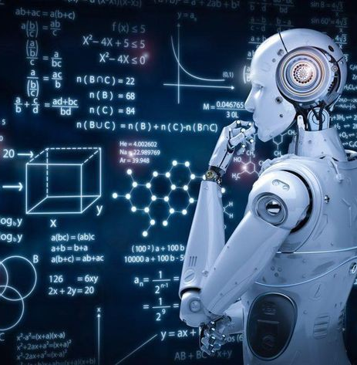


SUMMARY
At this presentation we have discussed robotics systems and its Dynamics, analysis and control . We also discussed the future of robotics systems.
Within mechanical engineering, robotics is the design and construction of the physical structures of robots, while in computer science, robotics focuses on robotic automation algorithms. Other disciplines contributing to robotics include electrical, control, software, information, electronic, telecommunication, computer, mechatronic, materials and biomedical engineering.

Slide 36
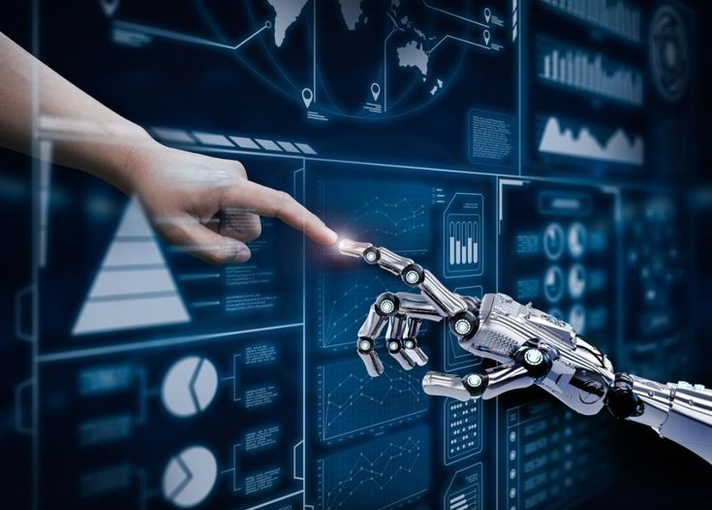
Thank you
Presented by :
Adham Abdelmohsen Elzewel
Supervised By:
Prof. Dr. Ahmed Hweidi

